Slide 3
Today’s Presenters
Colleen Lenahan
Richard Holder
Adrian Pacheco
Sr, Marketing Operations Consultant
Head of Marketing
System Analyst

Slide 4
Unlocking Job Function and Job Level from Job Titles in Eloqua
Eloqua Office Hours • January 25, 2024

Slide 5
The Problem
Job Title is generally well-populated from user-provided data and from data enrichment. Job Function and Job Level, however, are less well-populated.
Out-of-the-box Job Function and Job Level values may not work well for your company’s specific business needs.
It can be challenging to bucket contacts into only one Job Function value.

Slide 6
The Solution
Develop your own paradigm for Job Function and Job Level values that makes sense for your company and will be useful for segmenting email communications
Leverage Eloqua’s powerful automation capabilities to build the paradigm into a program that automatically populates these values

Slide 7
The Process
Analyze a sample set of contacts from your current database and draft keywords list for each Job Function and Job Level value
Rigorously test your program to ensure that it is mapping contacts correctly and make tweaks
1
2
3
4
5
Work with internal stakeholders to determine what values you want to use for Job Function and Job Level
Create new infrastructure in Eloqua: fields, filters, update rules, and contact program
Work with your CRM team to sync the fields from Eloqua to CRM and ensure data is flowing correctly
Notes:
In this presentation, I’m going to focus on steps 2-3, as those involve working with Eloqua

Slide 8
Choosing Keywords – Job Function
Value | Keywords
Banking Services (Retail, Corporate)
Business Development /Strategy
Card Related
Client Services /Experience
Digital /eCommerce /Innovation
Engineering
Finance
Fraud/Risk /Compliance
IT
Legal
Value | Keywords
Banking Services (Retail, Corporate) | Banking, Banking Services, Business Services, Commercial, Consumer Banking, Corporate, Lending, Retail
Business Development /Strategy | Business Development, BD, Business Strategy, CSO, Strategy, Strategic
Card Related | Card, Credit, Debit, Portfolio, Settlement
Client Services /Experience | Client Engagement, Client Experience, Client Services, Experience
Digital /eCommerce /Innovation | Digital, eCommerce, e-Commerce, e Commerce, eCom, eComm, eServices, Emerging, Innovation
Engineering | App, Developer, DevOps, Engineer
Finance | Accounting, CFO, Comptroller, Controller, Finance, Financial, Fin Ops
Fraud/Risk /Compliance | Chargeback, Compliance, Crime, Dispute, Fraud, Risk, Security
IT | IT, Tech, Technology, Technical
Legal | Attorney, CLO, Counsel, Lawyer, Legal
Value | Keywords
Loyalty
Marketing
Operations
Other
Partnerships /Alliances
Payments /Processing
Product
Project Management
Purchasing
Sales
Treasury
Value | Keywords
Loyalty | Loyalty
Marketing | Brand, CMO, Marketing
Operations | COO, Operations, Ops
Other | [default when no keyword matches found]
Partnerships /Alliances | Alliance, Partners
Payments /Processing | Payment, Processing
Product | Product
Project Management | Manager of *Projects, Project Manager, PM
Purchasing | Procurement, Purchasing, Sourcing
Sales | Revenue, Sales
Treasury | Treasurer, Treasury
Notes:
Need to make sure that the keywords are common enough in your contact database of job titles that they will be effective, but narrow enough that they won’t accidentally bring in unwanted contacts

Slide 9
Choosing Keywords – Job Level
Value | Keywords
C-Suite /President
VP-level
Director-level
Manager-level
Other
Value | Keywords
C-Suite /President | Chairman, Chief, C?O, Co-C?O, Founder, Officer, President EXCLUDE: Vice President
VP-level | AVP, Chief of Staff, EVP, General Manager, GM, Head, Owner, Principal, SVP, Vice President, VP EXCLUDE: Product Owner
Director-level | Dir, Dir., Dir,, Director
Manager-level | Manager, Mgr, PM
Other | [default when no keyword matches found]

Slide 10
Keyword Matching
Tips and Tricks
CEO .
CEO .
CEO
eCommerce
e-Commerce
e Commerce
eCom
eComm
CEO
COO
payment
payment
CFO
CSO
payments
C?O
CTO
CIO
President
Vice President
CLO
CMO
Notes:
For abbreviations like CEO, you need to utilize spaces in your keyword matching or Eloqua will look for that letter combination within other words
Account for variations in spelling, like for “e-commerce”
Always use the singular version of words, as that will pull in both the singular and plural versions
Use wildcard pattern matching to combine multiple values
Exclude terms that match one word but don’t fit into the category

Slide 11
Eloqua Assets
Fields for Job Function and Job Level (or repurpose existing)
Shared Filters that include the keyword matching on Job Title
Update Rules to update the Job Function and Job Level fields to the new values
Program Canvas
Notes:
Take multiselect needs into account for field creation

Slide 12
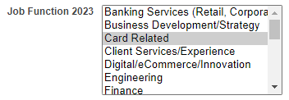
Multiselect Magic
Eloqua delimiter for multiselect options is :: (double colon)
Update Rule
Contact Record

Slide 13
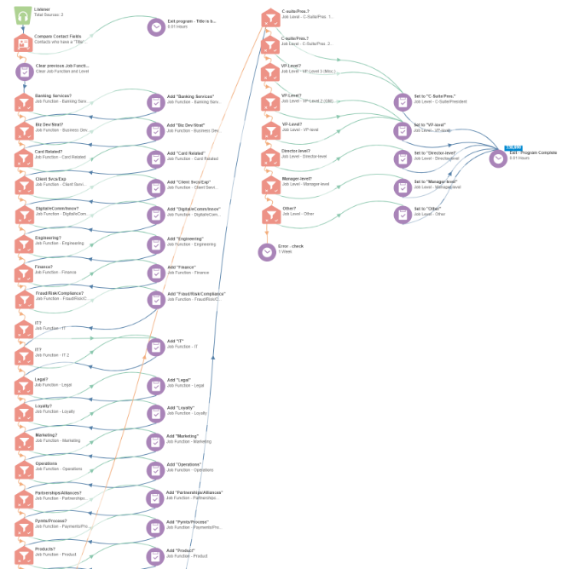
Job Level
Job Function
Program Canvas

Slide 14
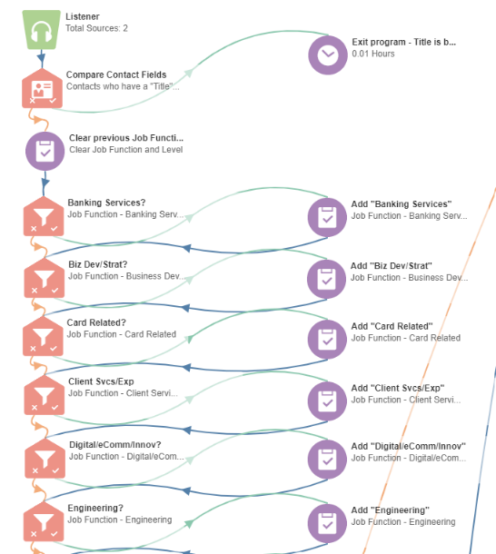
Job Function
If a match is found, the value is appended to the field and then the contact is moved to the next filter check

Slide 15
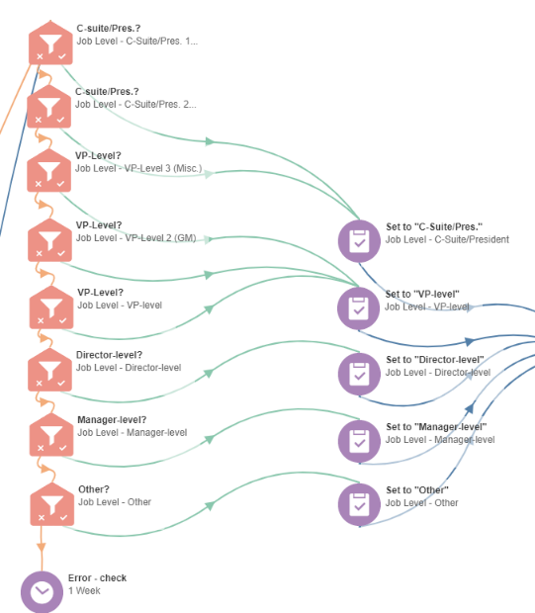
Job Level
If a match is found, the value is written to the field and the contact exits the flow

Slide 16
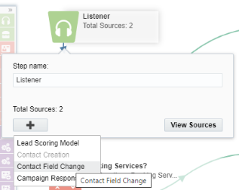
Listeners
Contact creation
Set up a Tracked Field for Job Title
Settings > Fields and Views > Tracked Fields

Slide 17
Next Steps – Test and Sync
Rigorously test your program to catch any contacts that have fallen through the cracks or who have been mapped incorrectly
Tweak and add keywords as needed
When everything is working as intended, work with CRM team to sync
Recommendation: make the fields “read-only” in CRM to avoid sync overwrite issues
Notes:
Make sure the values are coming across correctly
Use CRM codes if needed

Slide 18
Q&A
clenahan@4thoughtmarketing.com
+1 408 622 0082

Slide 19
Faster, Cleaner List Uploads
Eloqua Office Hours • January 25, 2024
Notes:
Despite all the integration options available to connect Eloqua with different data sources, list uploads are still a staple of most organizations. And while it seems like it should be a simple task, there are many factors that complicate the process.

Slide 20
List uploads should be quick and error-free
Notes:
In a perfect world, list uploads would be quick and error-free. However, what takes place behind the scenes is often like this picture. It’s a complex, multi-step, manual process to meticulously review and prepare lists, catch and correct potential errors, and validate and normalize the data to meet your company standards.

Slide 21
List Upload Challenges
Pre-scrubbing, validation and standardization
Duplicate records handling
Limited error messages
Option to save field mapping locally, no team sharing
Notes:
In addition, the way Eloqua handles duplicate records may not work for your company. Error reports from Eloqua often require extensive detective work to solve. And the mapping process cannot be saved and shared with other team members. And the list of challenges goes on.

Slide 22
Eloqua Upload Wizard
Notes:
Today, we will demonstrate the Eloqua Upload Wizard cloud app. It can help simplify the list upload process, reduce and prevent future errors, and automatically perform data validation and normalization. These are just a few examples of how the Upload Wizard can help your team scale without sacrificing quality or centralized control.

Slide 23
Q&A
info@4thoughtmarketing.com
+1 888-356-7824

